Slide 1



Mind Sculptor
An Obsessive-Compulsive Disorder(OCD) Exposure and Response Prevention(ERP) Therapy Tool
24-25J-046

Slide 2
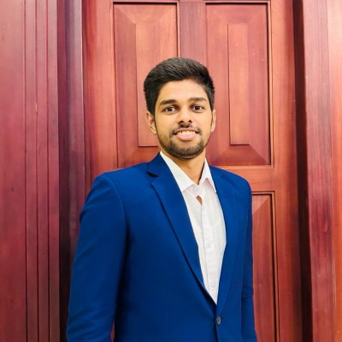
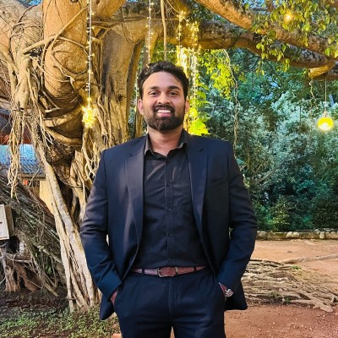
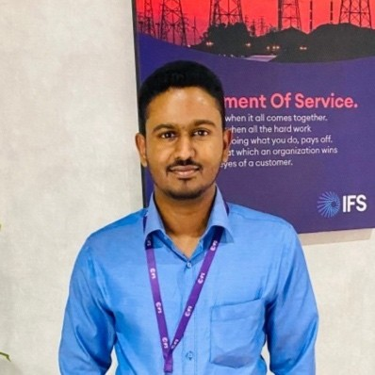
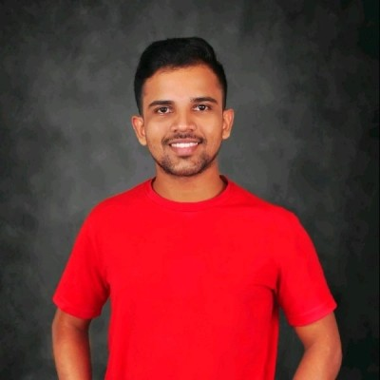
Our Team
Jayasighe P.T.
IT21234484
Mallawaarachchi D.E.H.
IT21209420
Illesinghe A.T.
IT21286278
Vithanage C.S.
IT21219498

Slide 3
INTRODUCTION
Obsessive-Compulsive Disorder(OCD) is a chronic psychiatric condition characterized by persistent intrusive thoughts (obsessions) and repetitive behaviors (compulsions).
It affects approximately 2-3% of the population and significantly impairs daily functioning and quality of life.
Traditional ERP therapy is effective but limited by accessibility and engagement challenges.
A comprehensive OCD ERP tool with advanced biometric monitoring and AI-driven therapeutic interventions has been identified as a valuable resource for enhancing the accessibility and effectiveness of obsessive-compulsive disorder treatment

Slide 4

Research Problem
How can AI and voice analysis improve the identification of OCD presence, subtypes and severity levels?
In what ways can biometric data and machine learning algorithms be used to create tailored ERP therapy plans for individual patients?
How can AI-supported Interactive Voice Assistant(IVA) increase patient engagement and accessibility to ERP therapy, particularly for those with logistical or psychological barriers?

Slide 5

Research Objectives
Main Objective
Sub Objectives
Develop an Exposure and Response Prevention(ERP) Therapy tool for patients suffering from OCD.
To enhance the diagnosis and understanding of OCD subtypes
To develop personalized and adaptive ERP therapy plans
To create AI-supported Interactive Voice Assistant(IVA)
To enable remote and real-time monitoring of therapy sessions

Slide 6
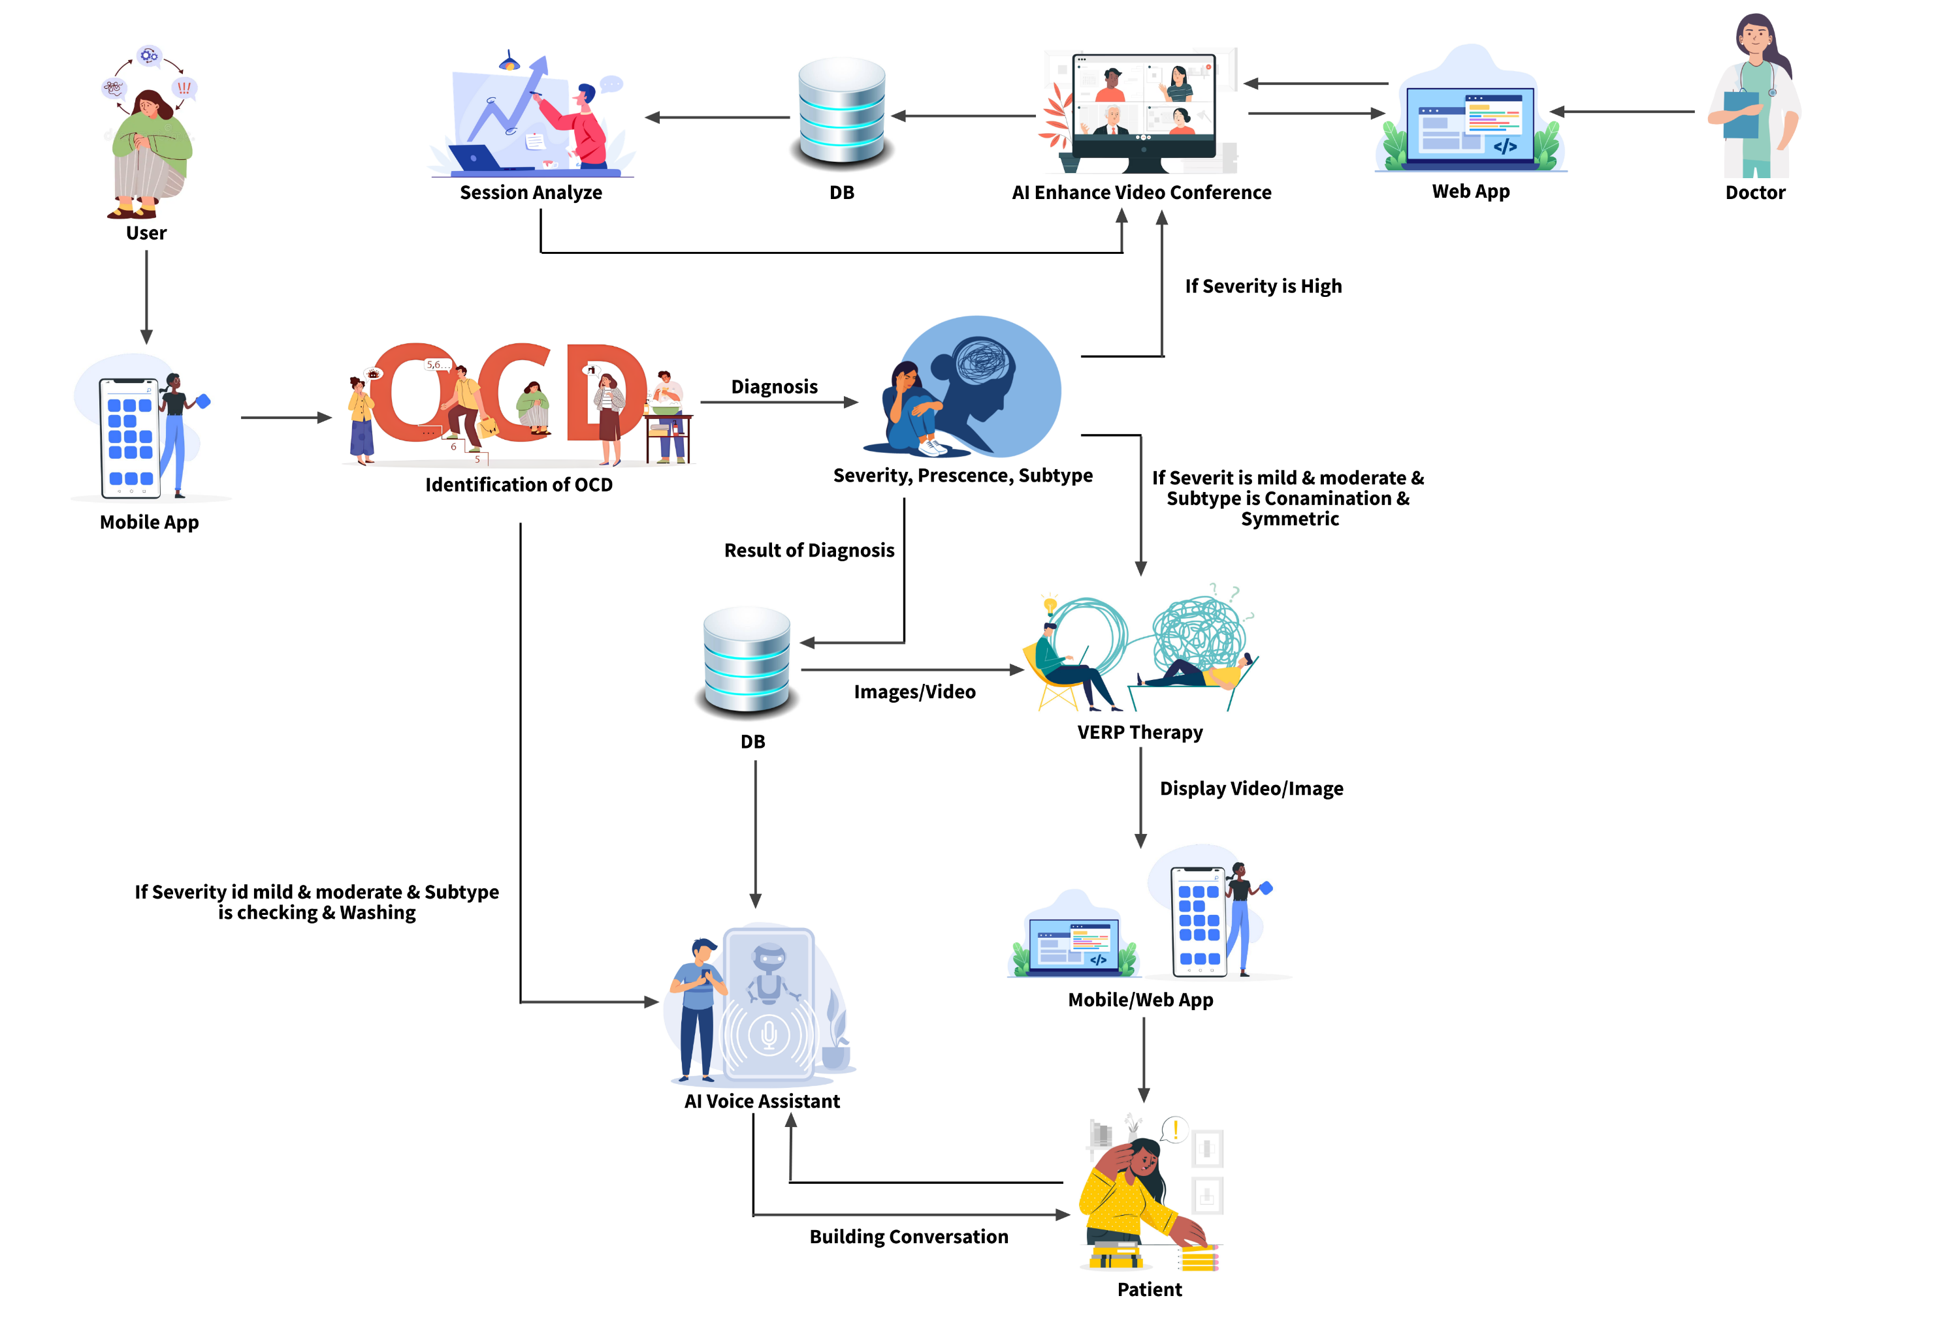
System Diagram

Slide 7
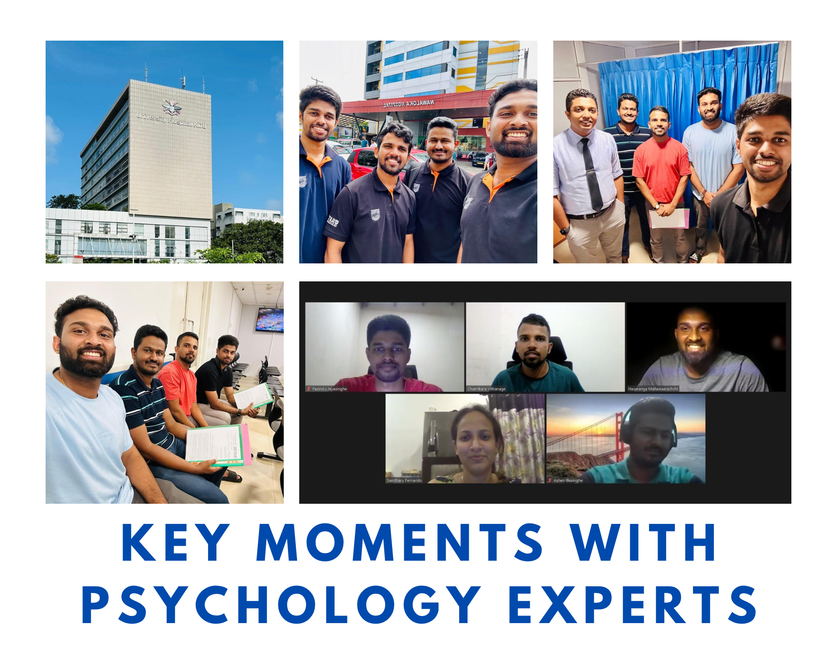
Data Collection

Slide 8
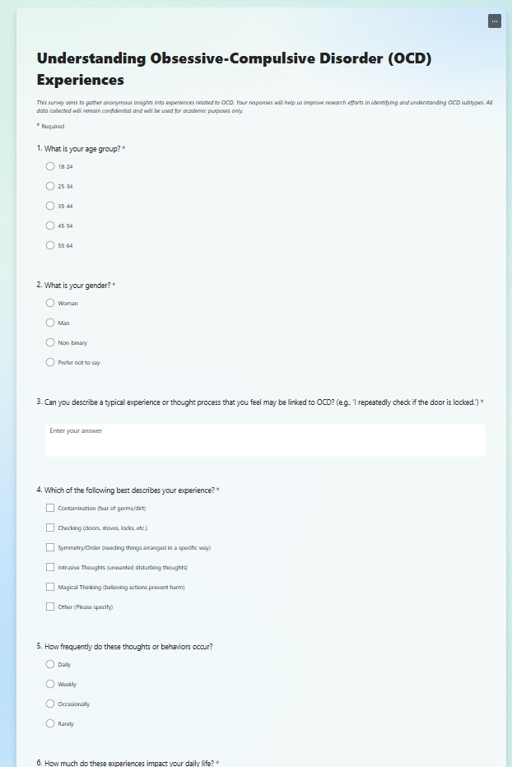
Data Collection through FAQ

Slide 9
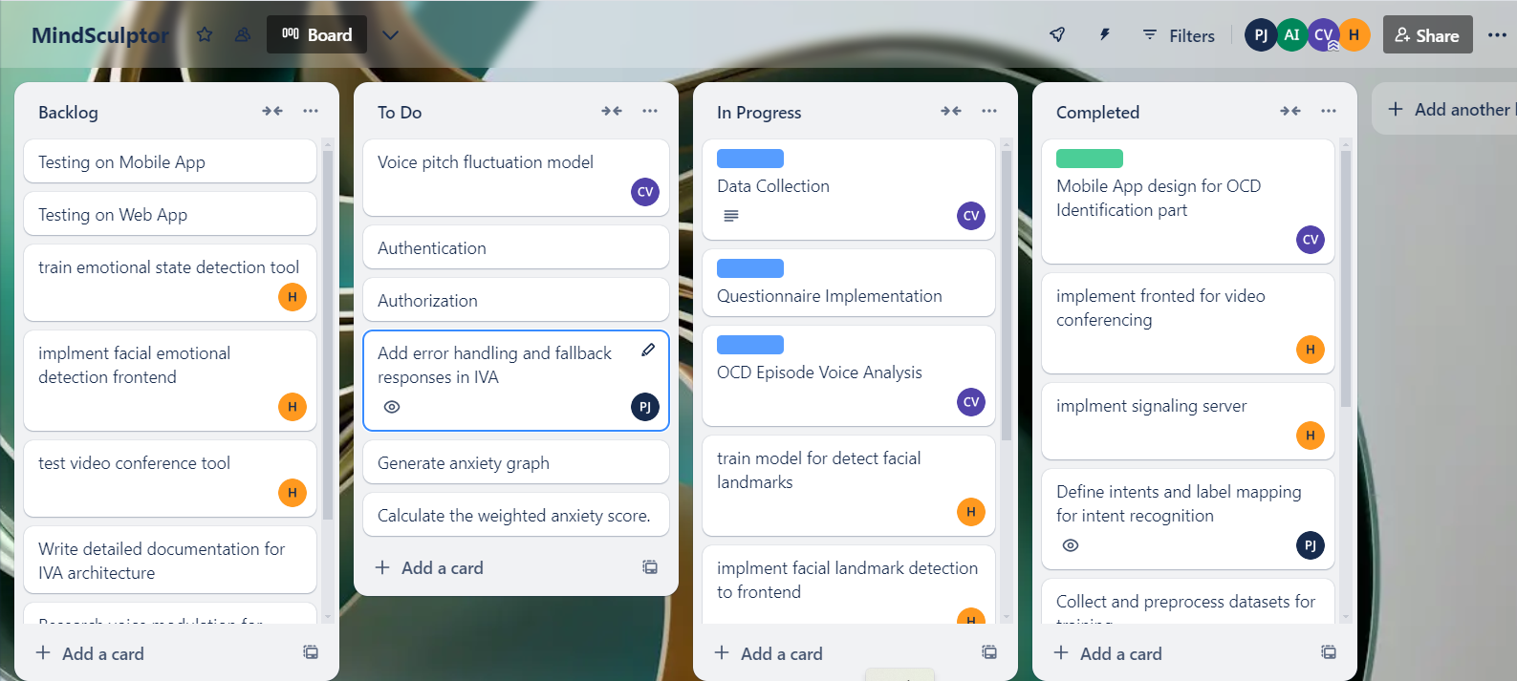
Best Practices Followed
Proper usage of Comments.
Project Management performed using Trello.

Slide 10
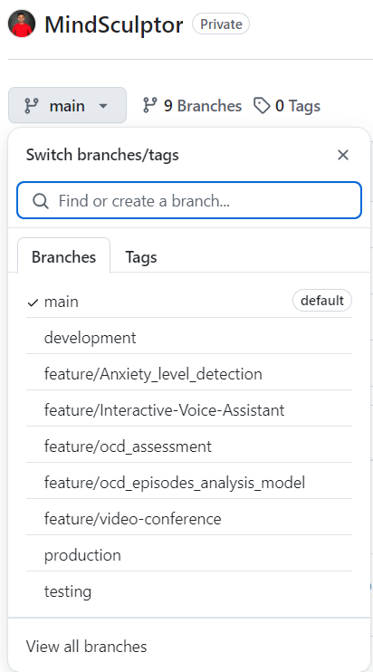
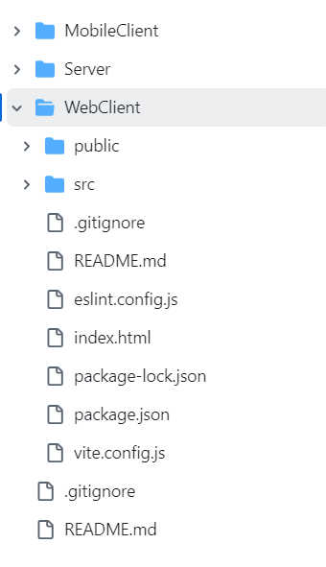
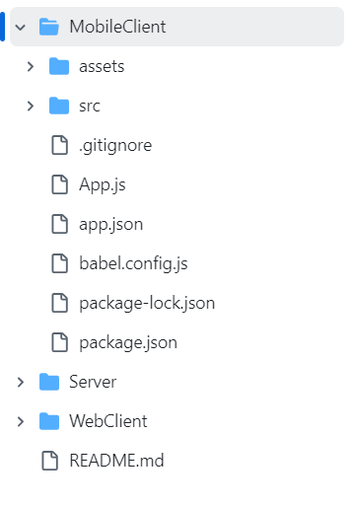
Best Practices Followed
Optimized Feature-vise and Environment-vise branching

Slide 11
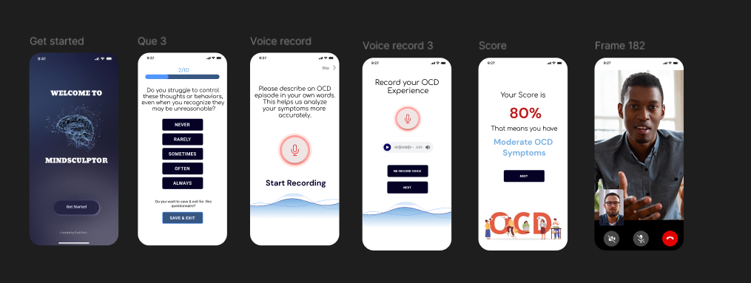
UI Design - Mobile

Slide 12
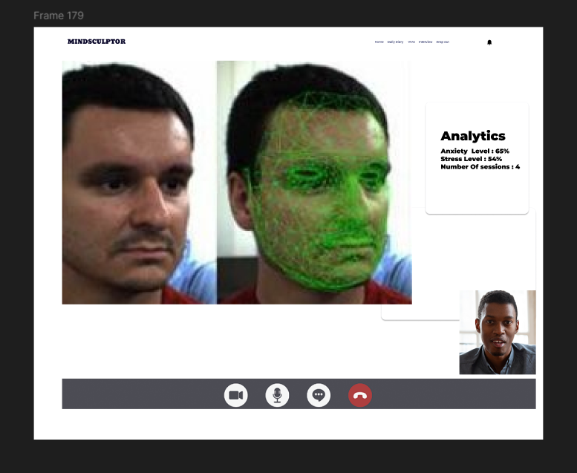
UI Design - Web

Slide 13
Identify the presence, severity, and sub types of OCD in patients
IT21219498 | Vithanage C.S.
Specialization: Software Engineering
IT21219498 | Vithanage C.S | 24 – 25J – 046

Slide 14

Introduction
Background on OCD
Obsessive-Compulsive Disorder (OCD) is a mental health condition characterized by unwanted and intrusive thoughts (obsessions) and repetitive behaviors (compulsions).
It affects individuals' daily functioning and quality of life.
Importance of the Study
Identifying the presence, severity, and sub-types of OCD can lead to better diagnosis, treatment, and understanding of the disorder.
Accurate assessment helps in providing tailored interventions and improving patient outcomes.
IT21219498 | Vithanage C.S | 24 – 25J – 046

Slide 15

Research Questions
Primary Questions
How can the presence of OCD be accurately identified in patients using modern technological methods?
What are the most effective techniques to determine the severity of OCD symptoms?
How can different sub-types of OCD be classified and differentiated in patients?
Secondary Questions
Can voice recordings and speech analysis provide additional insights into OCD symptoms?
What algorithms and techniques are most suitable for these assessments?
IT21219498 | Vithanage C.S | 24 – 25J – 046

Slide 16
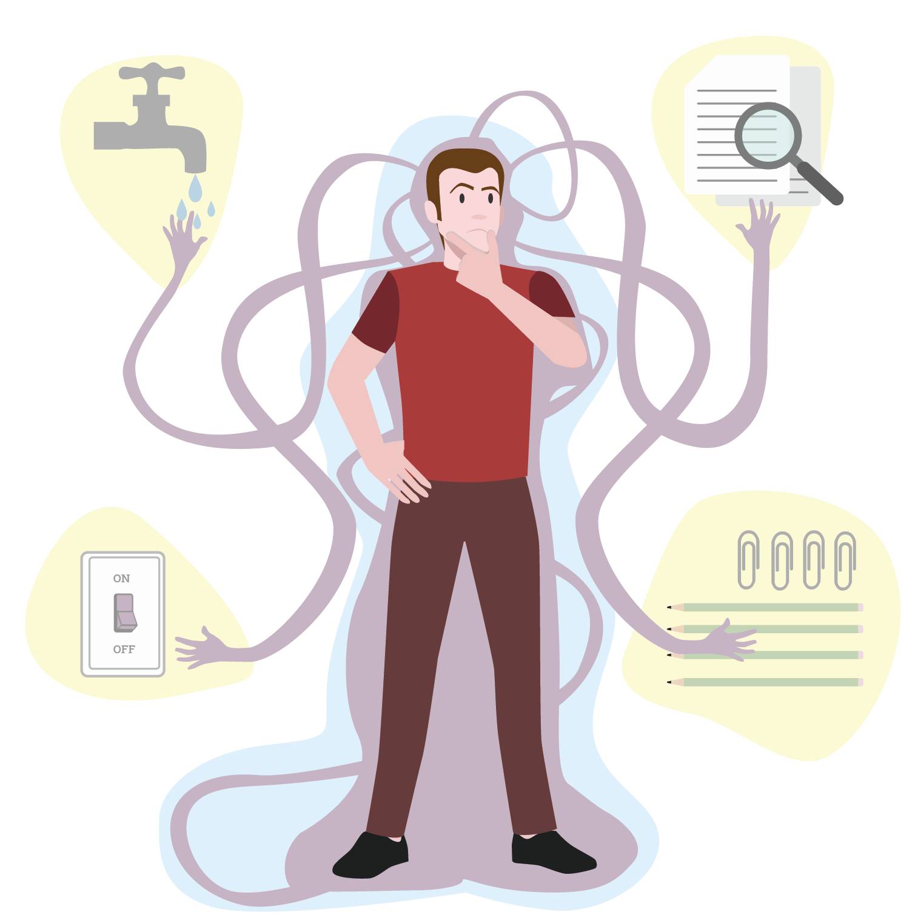
Objectives
Main Objective
Sub Objectives
Develop a comprehensive assessment method for identifying the presence, severity, and sub-types of OCD in patients.
Questionnaire-Based Assessment:
Implement a dynamic questionnaire to provide a preliminary diagnosis based on user responses.
OCD Episodes Analysis:
Leverages BERT for fine-tuned multi-class classification to identify OCD subtypes and severity levels from episode descriptions
Voice Pitch Fluctuation Analysis:
Analyze voice pitch fluctuations to assess emotional state and severity of OCD.
Final Diagnosis:
Combine results from all sub-components to produce a comprehensive OCD diagnosis.

Slide 17
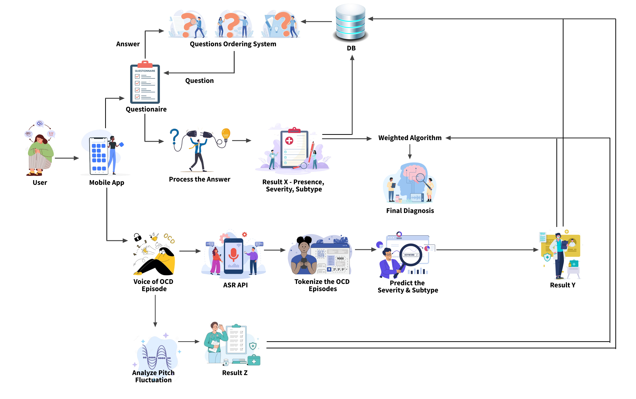
Methodology – System Diagram
IT21219498 | Vithanage C.S | 24 – 25J – 046

Slide 18
Methodology – Technologies, Techniques, Algorithms
Techniques
Technologies
Algorithms
Expo
React Native
Python
Flask
MongoDb
Matplotlib & Seaborn
Jupyter
Librosa
NLTK
Scikit-learn
Hugging Face Transformers
WordCloud
Speech recognition
Fine-Tuning BERT
Text Preprocessing
BERT
Decision Tree algorithm
Weighted scoring algorithm
IT21219498 | Vithanage C.S | 24 – 25J – 046

Slide 19
Methodology – Evidence of Completion
Overview of Achievements
Implemented Models:​
OCD Episode Analysis Model (Subtype & Severity Prediction).
Data Preparation:
Generated and processed a realistic OCD dataset with over 1,000 episodes.
Balanced coverage of all subtypes and severity levels.
Questionnaire Development:
Dynamic questionnaire system based on Y-BOCS and OCI-R standards.
Model Deployment:
Developed Flask-based APIs for real-time predictions.
IT21219498 | Vithanage C.S | 24 – 25J – 046

Slide 20
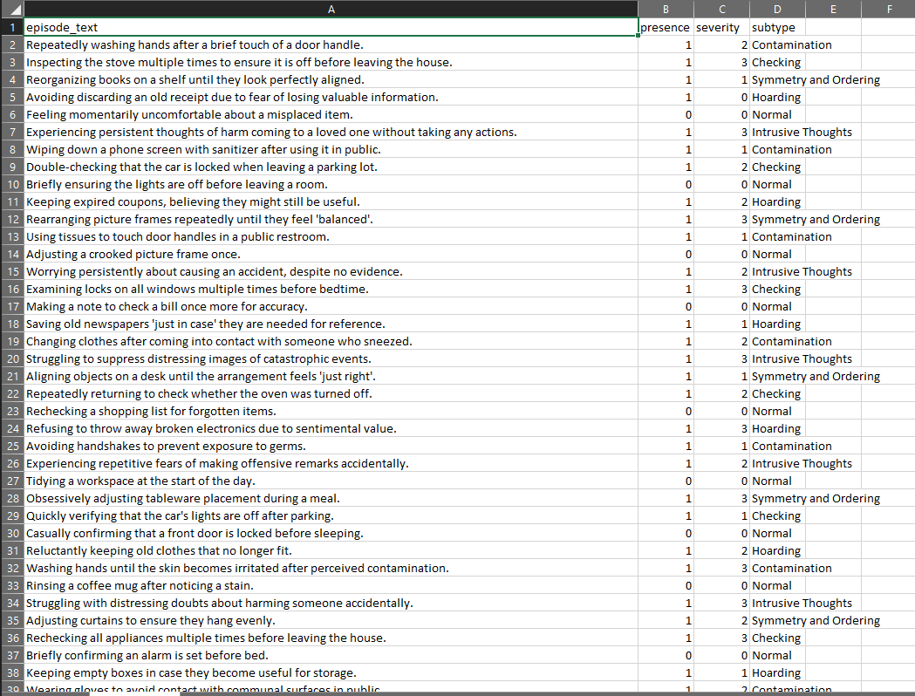
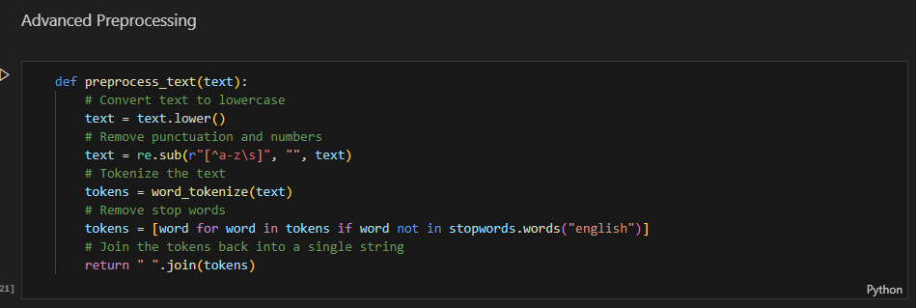
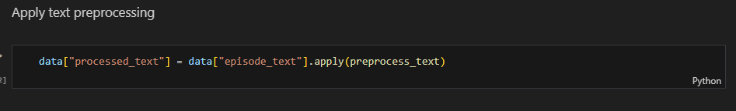
Methodology – Evidence of Completion
Data Collection and Preprocessing
Dataset Highlights:
Preprocessing Techniques:
IT21219498 | Vithanage C.S | 24 – 25J – 046

Slide 21
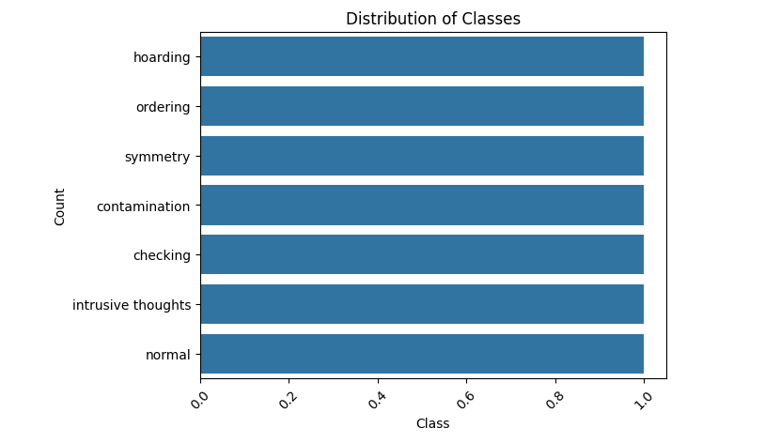
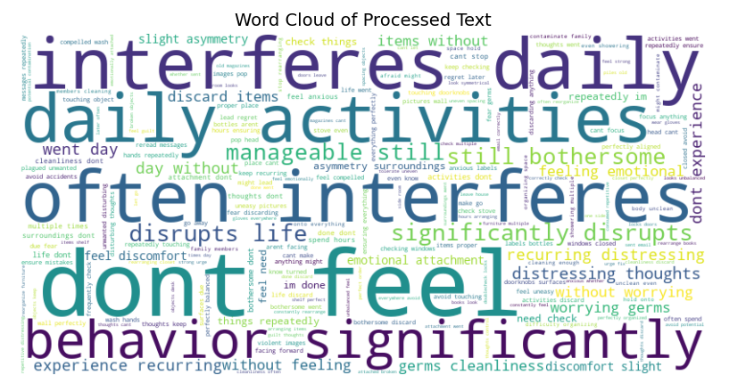
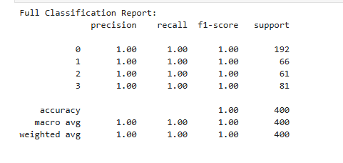
Methodology – Evidence of Completion
Data Visualization
IT21219498 | Vithanage C.S | 24 – 25J – 046

Slide 22
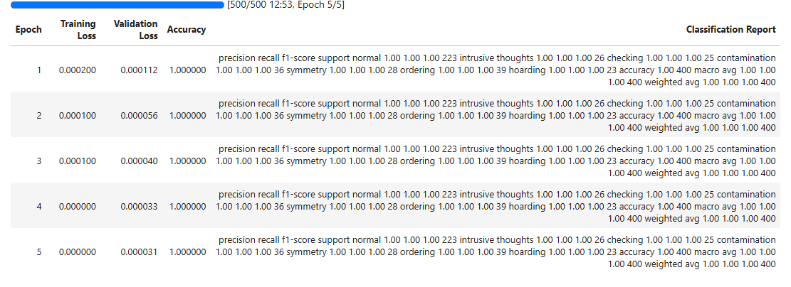
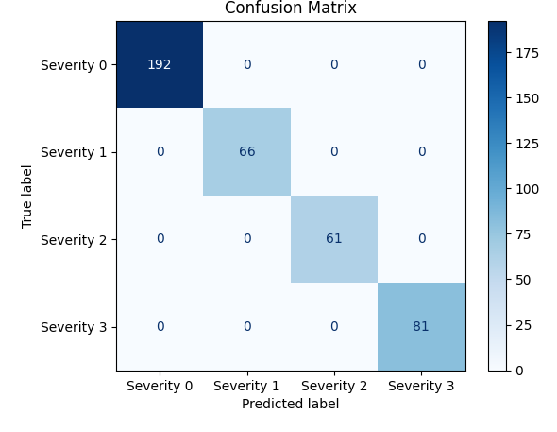
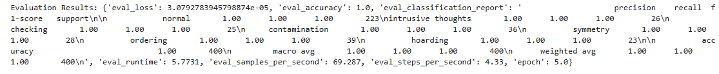
Methodology – Evidence of Completion
Evaluation Results
IT21219498 | Vithanage C.S | 24 – 25J – 046

Slide 23
Methodology – System, Personal, and Software Specification Requirement
Functional Requirements
Develop a dynamic 15 to 20-questions questionnaire with algorithmic question ordering to assess OCD presence, severity, and subtype.
Capture and convert patient voice recordings to text using ASR API, and identify severity and the subtype using finetuned BERT model.
Analyze pitch fluctuations using Librosa to derive insights into the patient's emotional state and behavior.
Integrate results from questionnaire, OCD episode analysis, and pitch analysis using ensemble learning for a final diagnosis or severity level.
Non-Functional Requirements
Ensure efficient processing of questionnaire responses and voice data with minimal latency.
Design an intuitive, user-friendly mobile application interface accessible to users with varying technical expertise.
Support multiple users and large datasets, scaling to accommodate growth.
Implement strong encryption for data security, ensuring compliance with GDPR, HIPAA, and other regulations to protect patient confidentiality and handle sensitive information securely.
Software requirements
Python
Flask
React Native
Librosa
ASR APIs
Jupyter
NLTK, scikit-learn
Personal requirements
Dr. Roshan Fernando: Psychiatrist guiding the overall research project, providing insights into OCD diagnosis and treatment methodologies.
Ms. Sandaru Fernando: Psychologist assisting in the development of the dataset and providing expertise in psychological assessment.
IT21219498 | Vithanage C.S | 24 – 25J – 046

Slide 24
Methodology – Completion and
Future Works
60% Completion of the component
Created a Comprehensive Dataset
Developed BERT-based models for predicting
Implemented dynamic questionnaire based on Y-BOCS and OCI-R standards.
Integrated Flask APIs for real-time predictions of subtype and severity.
Integrated the dynamic questionnaire with Mobile App.
Implement the Speech to Text Conversion of OCD episodes using ASR Api.
Implement voice pitch fluctuation analysis part.
Combined the results of Questionnaire, OCD Episode analysis and Voice Pitch Analysis.
Implement the UI Design and API Integrations.
Integrate and Test the application.
40% Future Enhancements
IT21219498 | Vithanage C.S | 24 – 25J – 046

Slide 25
References
[1] B. Pascual-Vera, M. Roncero, G. Doron, and A. Belloch, “Assisting relapse prevention in OCD using a novel mobile app–based intervention: A case report,” Bulletin of the Menninger Clinic, vol. 82, no. 4, pp. 390–406, Dec. 2018, doi: https://doi.org/10.1521/bumc.2018.82.4.390.
‌
[2] M. Gershkovich et al., “Integrating exposure and response Prevention with a mobile app to treat Obsessive-Compulsive Disorder: Feasibility, Acceptability, and preliminary Effects,” Behavior Therapy, vol. 52, no. 2, pp. 394–405, Mar. 2021, doi: 10.1016/j.beth.2020.05.001.
[3] T. D. Hull and K. Mahan, “A Study of Asynchronous Mobile-Enabled SMS Text Psychotherapy,” Telemedicine journal and e-health : the official journal of the American Telemedicine Association, vol. 23, no. 3, pp. 240–247, 2017, doi: https://doi.org/10.1089/tmj.2016.0114.
[4] E. McIngvale, C. Bakos-Block, J. Hart, and P. S. Bordnick, “Technology and Obsessive Compulsive Disorder: An Interactive Self-Help Website for OCD,” Journal of Technology in Human Services, vol. 30, no. 2, pp. 128–136, Apr. 2012, doi: https://doi.org/10.1080/15228835.2012.699368.
‌
IT21219498 | Vithanage C.S | 24 – 25J – 046

Slide 26
Enhanced Exposure and Response Prevention Therapy
IT21286278 | Illesinghe A.T.
Specialization: Software Engineering
IT21286278 | Illesinghe A. T. | 24 – 25J – 046

Slide 27
Introduction
Background
Exposure and Response Prevention(ERP) therapy is commonly used treatment by psychiatrists for patients diagnosed with Obsessive-Compulsive Disorder(OCD).
Exposure and Response Prevention(ERP) therapy, have proven effective in reducing symptoms and improving outcomes for OCD patients.
Enhanced Exposure and Response Prevention(VERP) is an innovative approach to treating OCD patients.
VERP uses advanced technology to simulate OCD-inducing scenarios and integrates biometric data to enhance the effectiveness of traditional exposure therapy.
VERP can be used to treat patients with symmetric OCD, contamination OCD, sexual orientation OCD.
IT21286278 | Illesinghe A. T. | 24 – 25J – 046

Slide 28

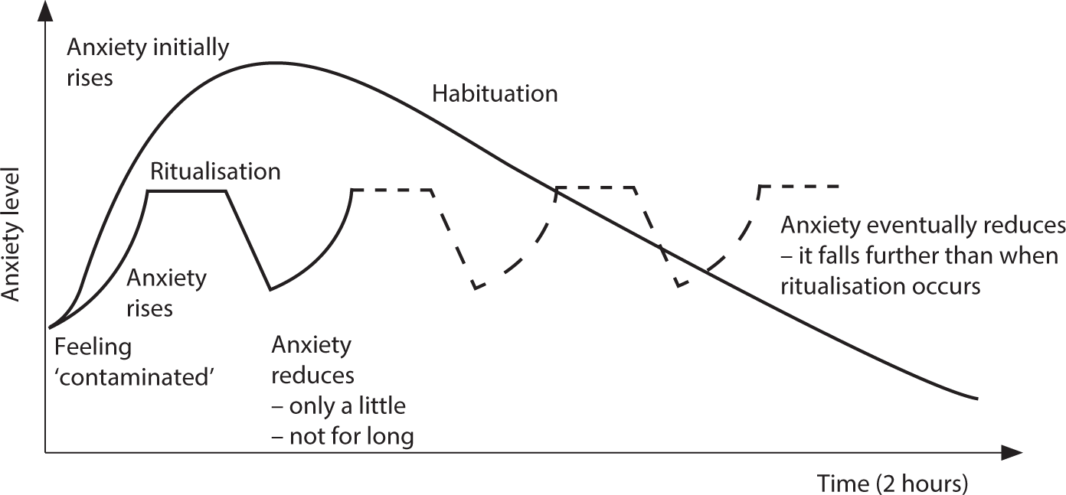
Introduction
Importance of the Study
First, the patient is exposed to an OCD-inducing scenario using images/videos.
Then the anxiety graph is generated using patient self-reported data and bio metric data.
Patients can seek the therapy on their own without consulting a doctor and reduce the symptoms of the OCD.
Patients can monitor the effectiveness of treatment by analyzing anxiety charts.
Contamination OCD
Anxiety graph
IT21286278 | Illesinghe A. T. | 24 – 25J – 046

Slide 29
Research Questions
How can we virtually expose patients to OCD inducing scenarios?
How can response prevention therapy be implemented using modern technology?
How can the accuracy of response prevention therapy be increased using modern technology?
IT21286278 | Illesinghe A. T. | 24 – 25J – 046

Slide 30
Objectives
Main Objective
Sub Objectives
Simulate real-life scenarios using tailored videos and images to expose the patient to OCD triggering scenario.
Capture biometric data and patient self-reported data during therapy session.
Generate the anxiety graph using captured biometric data and self-reported data.
Analyze anxiety graphs to predict the patient’s treatment efficacy.
To develop a therapy system that utilizes virtual simulations and biometric data to effectively treat Obsessive-Compulsive Disorder (OCD).
IT21286278 | Illesinghe A. T. | 24 – 25J – 046

Slide 31
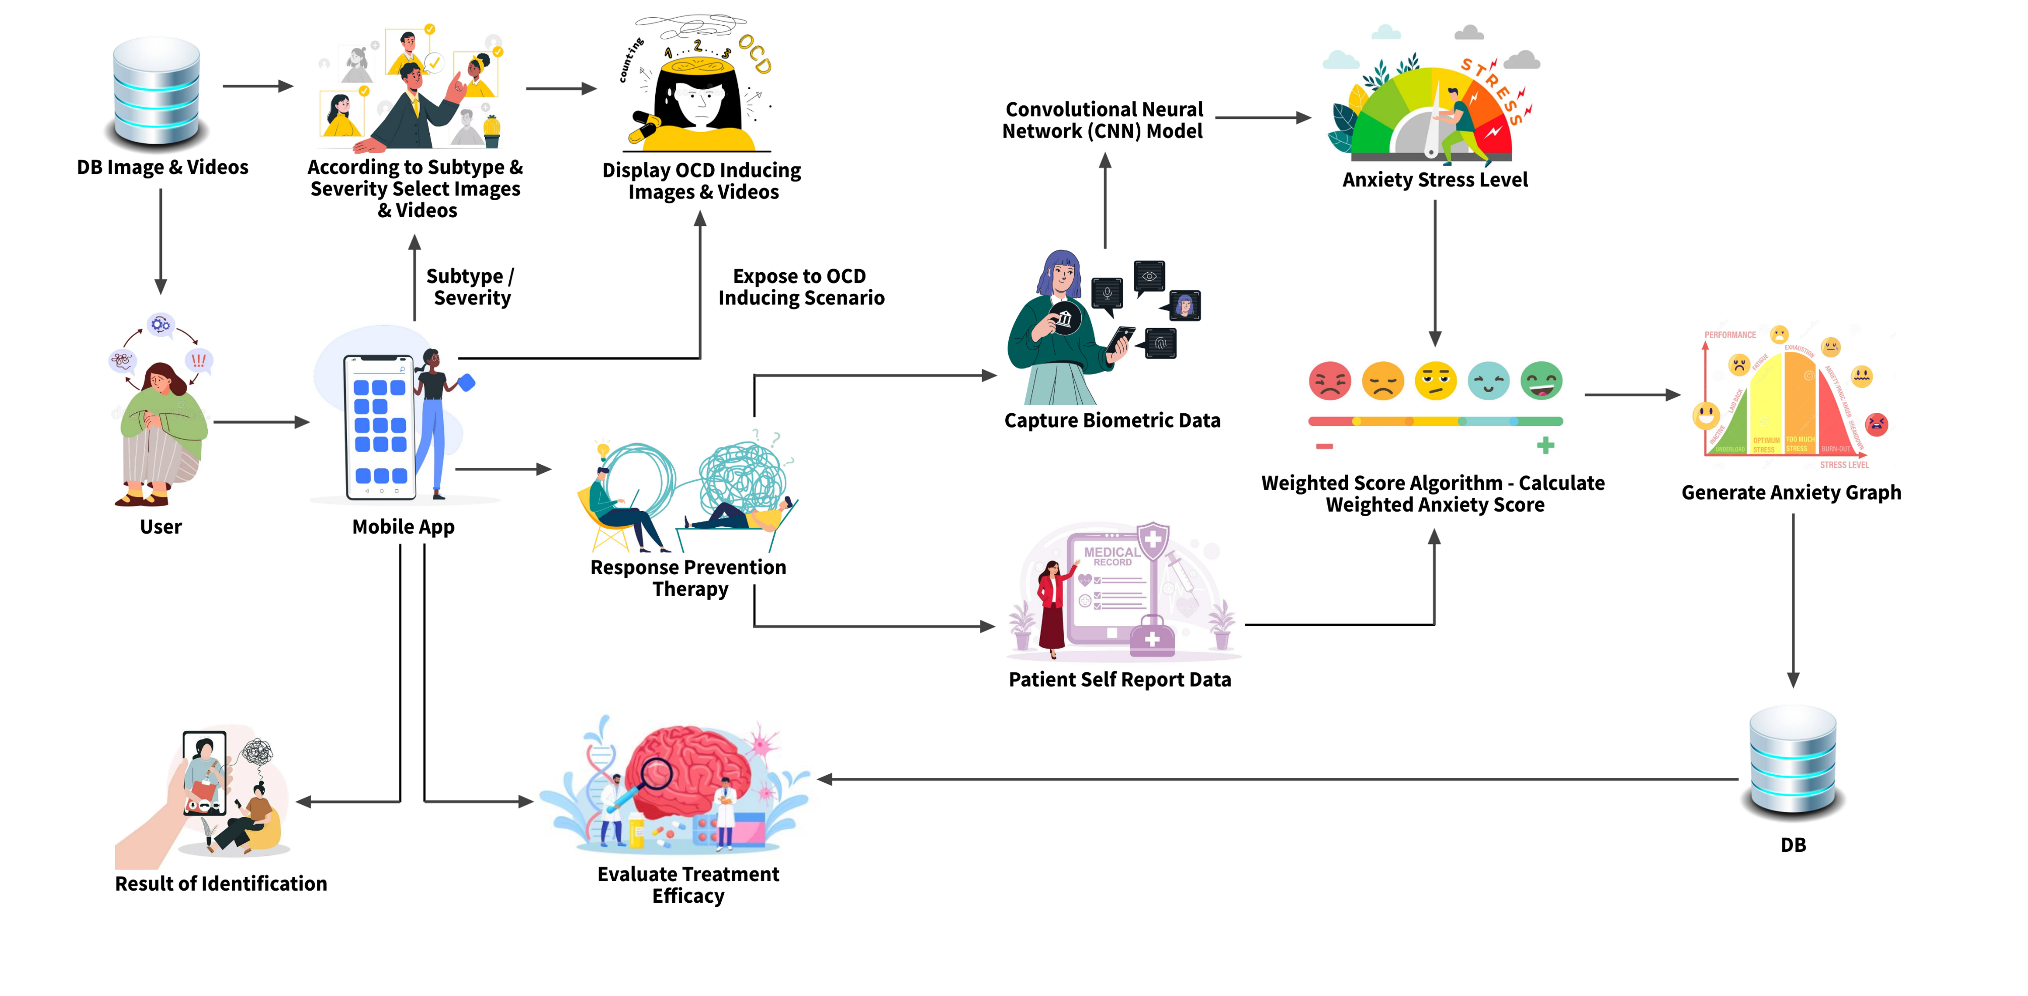
Methodology – System Diagram
IT21286278 | Illesinghe A. T. | 24 – 25J – 046

Slide 32
Methodology – Technologies, Techniques, Algorithms
Techniques
Technologies
Algorithms
Facial recognition
Emotion detection
Machine learning
Deep learning
Graph visualization.
React
Expo
React Native
TensorFlow
Python Flask
NodeJs
MongoDb/Mysql
Vscode
Google Colab
Convolutional Neural Network (CNN)
Decision Tree algorithm
Weighted scoring algorithm
CNN architectures
VGG-Face
Google Facenet
OpenFace
ResNet
MobileNet
IT21286278 | Illesinghe A. T. | 24 – 25J – 046

Slide 33
Evidence of completetion
Data Collection
Train several models using different CNN architectures to select the best architecture
Data pre-processing
Visualized the accuracy and training and validation loss of trained models
Used Convolutional Neural Network(CNN) architectures for training model to detect anxiety level
Exposure of patient to visual elements based on subtype and severity of the OCD
IT21286278 | Illesinghe A. T. | 24 – 25J – 046

Slide 34




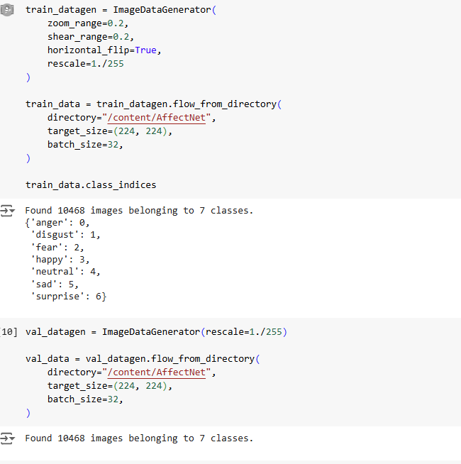



Data Collection and Pre-processing
Dataset name - AffectNet
Data pre-processing
Emotion Type | Image Count
Angry | 599
Disgust | 599
Fear | 599
Happy | 599
Neutral | 600
Sad | 599
Surprise | 599
Total | 4194
IT21286278 | Illesinghe A. T. | 24 – 25J – 046

Slide 35
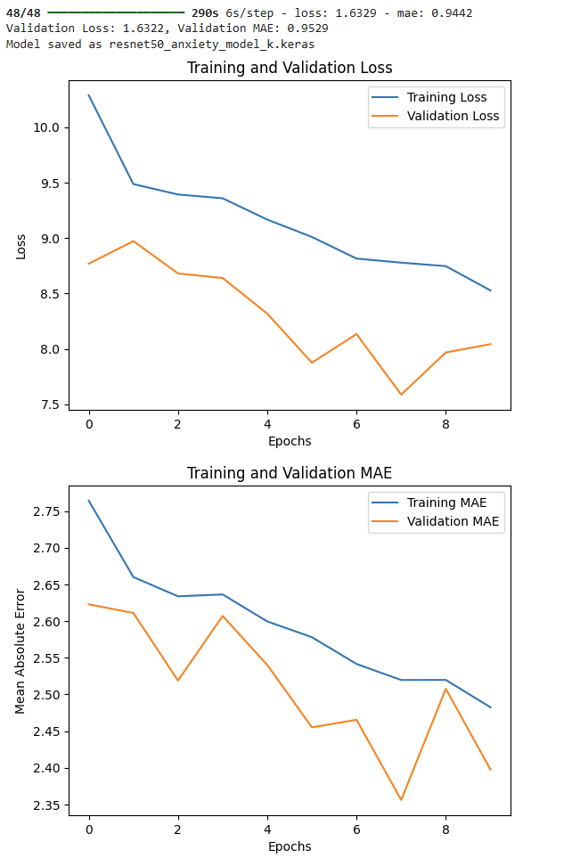
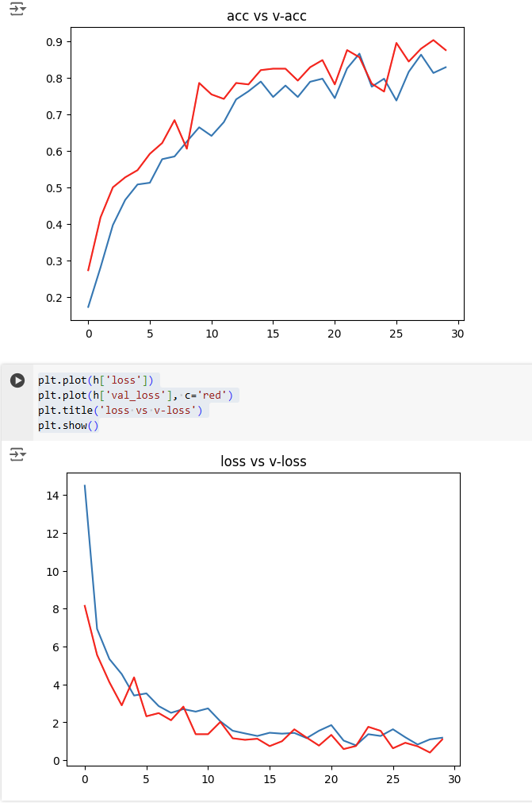
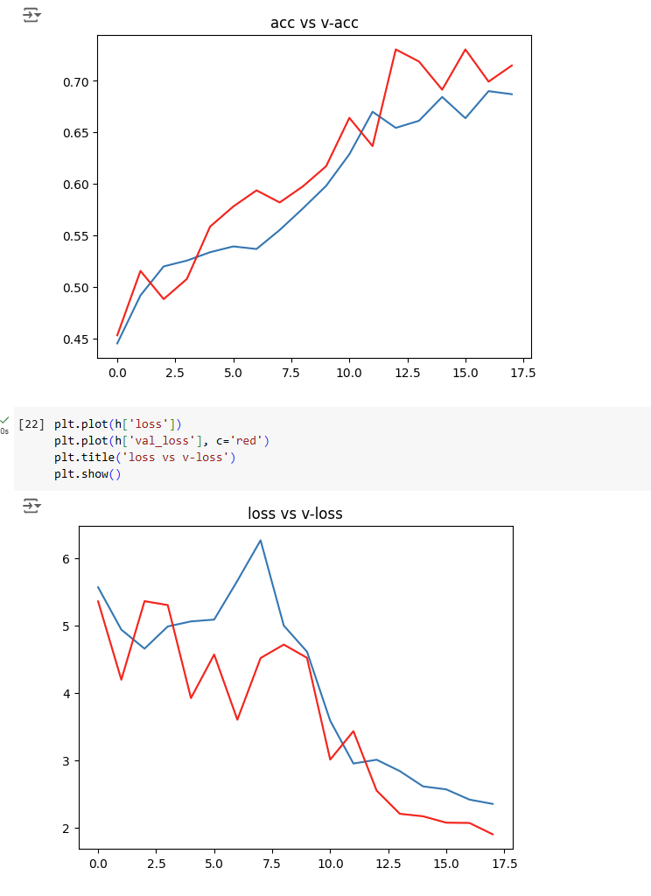
CNN Architectures
ResNet50
MobileNet
VGG16
Accuracy = 89.45
IT21286278 | Illesinghe A. T. | 24 – 25J – 046

Slide 36
Methodology – System, Personal, and Software Specification Requirement
Functional Requirements
Display appropriate image/video based on the OCD sub type and severity of the patient.
Capture accurate anxiety/stress level using emotion detection during the therapy.
Capture the patient self-reported data.
Calculate the weighted anxiety score accurately using facial expression data and user input data.
Generate the anxiety graph using the weighted anxiety score.
Analyze anxiety graphs of the patient.
Non-Functional Requirements
The application should be reliable and efficient.
Interfaces should be user-friendly.
The application should be compatible with different devices.
Patient data must be secure.
The results of VERP therapy must be accurate.
Software requirements
Python
Node
React
Vscode
MongoDB/
Google Colab
Personal requirements
Guidance of external supervisors to acquire knowledge of healthcare domain.
Data set to train the CNN model.
IT21286278 | Illesinghe A. T. | 24 – 25J – 046

Slide 37
Completion and Future work
50% Completion of the component
Collect data and pre-process the data.
Train the CNN model to capture the anxiety level of the patient.
Train several models using different CNN architectures to identify the most suitable model.
Develop the backend API for retrieve visual elements based on the patient’s severity and subtype of the OCD.
50% Future enhancements
Fine tune the CNN model to achieve more accuracy.
Implement the API to collect user data during the VERP therapy.
Calculate the weighted anxiety score using user entered data and biometric data.
Generate the anxiety graph using the weighted anxiety score.
IT21286278 | Illesinghe A. T. | 24 – 25J – 046

Slide 38
References
[1] B. Pascual-Vera, M. Roncero, G. Doron, and A. Belloch, “Assisting relapse prevention in OCD using a novel mobile app–based intervention: A case report,” Bulletin of the Menninger Clinic, vol. 82, no. 4, pp. 390–406, Dec. 2018, doi: https://doi.org/10.1521/bumc.2018.82.4.390.
‌
[2] M. Gershkovich et al., “Integrating exposure and response Prevention with a mobile app to treat Obsessive-Compulsive Disorder: Feasibility, Acceptability, and preliminary Effects,” Behavior Therapy, vol. 52, no. 2, pp. 394–405, Mar. 2021, doi: 10.1016/j.beth.2020.05.001.
[3] T. D. Hull and K. Mahan, “A Study of Asynchronous Mobile-Enabled SMS Text Psychotherapy,” Telemedicine journal and e-health : the official journal of the American Telemedicine Association, vol. 23, no. 3, pp. 240–247, 2017, doi: https://doi.org/10.1089/tmj.2016.0114.
[4] E. McIngvale, C. Bakos-Block, J. Hart, and P. S. Bordnick, “Technology and Obsessive Compulsive Disorder: An Interactive Self-Help Website for OCD,” Journal of Technology in Human Services, vol. 30, no. 2, pp. 128–136, Apr. 2012, doi: https://doi.org/10.1080/15228835.2012.699368.
IT21286278 | Illesinghe A. T. | 24 – 25J – 046

Slide 39
AI Supported Interactive Voice Assistant
IT21234484 | Jayasinghe P.T.
Specialization: Software Engineering
IT21234484 | Jayasinghe P.T. | 24 – 25J – 046

Slide 40

Stigma in Society
Mental health disorders are often stigmatized, leading to fear of judgment or discrimination.
This stigma prevents many from openly discussing their struggles or seeking help, worsening their condition over time.
Reluctance to Seek Help
Concerns about being labeled or misunderstood result in a hesitation to pursue traditional therapy.
Cultural pressures and misconceptions around mental health reinforce the idea that seeking help is a sign of weakness.
Geographical Barriers
Access to mental health services is severely limited in rural and remote areas, where traveling to see a therapist can be impractical or impossible.
These geographical challenges create a significant gap in mental health care for those living in underserved regions.
Introduction
IT21234484 | Jayasinghe P.T. | 24 – 25J – 046

Slide 41
Research Questions
How can AI supported Interactive Voice Assistant enhance accessibility and personalization of ERP therapy for OCD patients?
IT21234484 | Jayasinghe P.T. | 24 – 25J – 046

Slide 42
Objectives
Main Objective
Sub Objectives
Conduct ERP Therapy Sessions for Contamination OCD Subtype.
Identification of Exposure Type and Severity Level of patients.
Generate Appropriate Therapeutic Responses
Utilize patient input to dynamically generate and provide personalized therapeutic responses during the therapy session.
Evaluate Patient Progress and Emotional Response
Implementation of an AI-Supported Interactive Voice Assistant for ERP Therapy in OCD
IT21234484 | Jayasinghe P.T. | 24 – 25J – 046

Slide 43
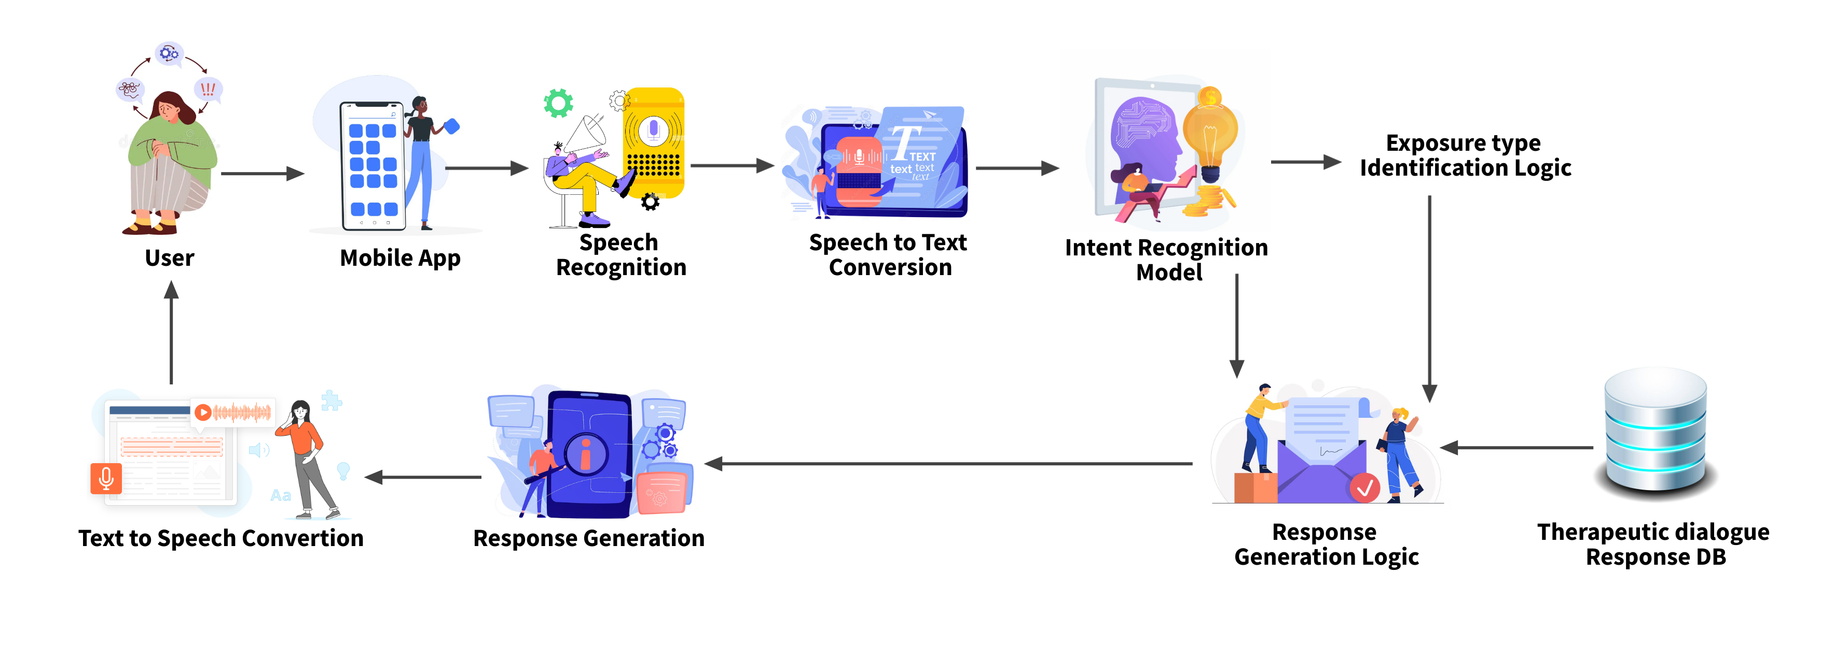
Methodology – System Diagram
IT21234484 | Jayasinghe P.T. | 24 – 25J – 046

Slide 44
Methodology – Technologies, Techniques, Algorithms
Techniques
Technologies
Algorithms
Expo
React Native
Flask
NodeJs
MongoDb/Mysql
Python
Vscode
Google Colab
Transformers
TensorFlow
Natural Language Processing
Speech recognition
Keyword detection
Machine learning
Rule-based Logic
Matching Algorithm for Keyword-Based Exposure Type Detection.
State-Based Rule Logic for Conversational Flow
Metrics: Confusion Matrix, Classification Report.
Loss and Accuracy Tracking Across Epochs.
IT21234484 | Jayasinghe P.T. | 24 – 25J – 046

Slide 45
Methodology – Evidence of Completion
Fine-tuned DistilBERT for lightweight and efficient intent classification.
Data Collection
Data pre-processing
Tuning hyper-parameters and retrained models to select the best architecture
Data Visualization
Implemented state-based rule logic for seamless conversational flow.
Used keyword-matching algorithms for real-time exposure type identification
IT21234484 | Jayasinghe P.T. | 24 – 25J – 046

Slide 46
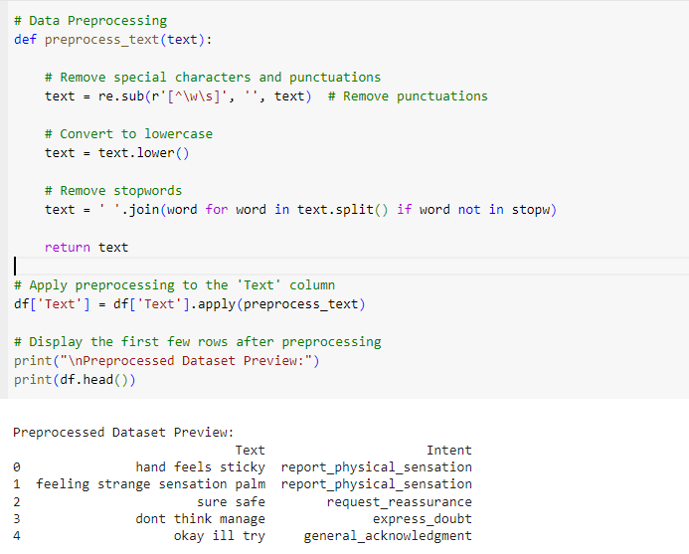
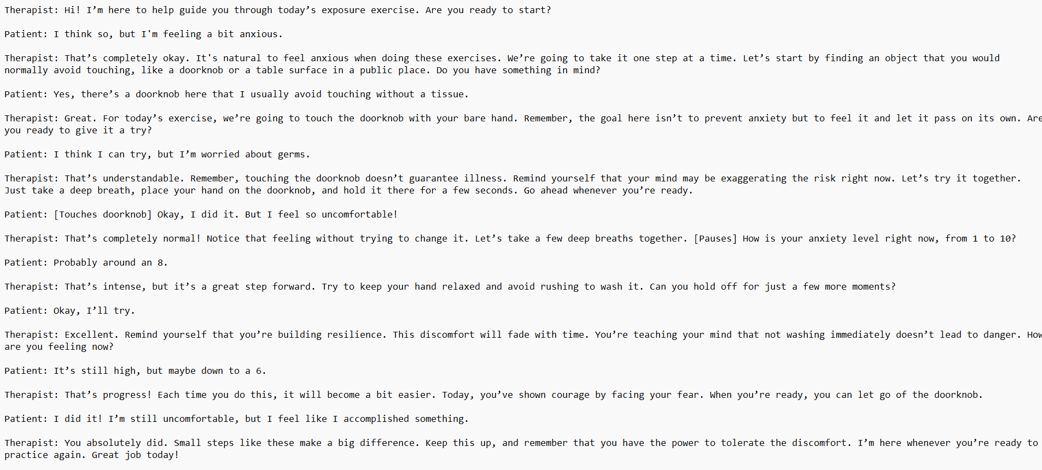
Data Collection and Pre-processing
Data pre-processing implementation
Collected conversation data
IT21234484 | Jayasinghe P.T. | 24 – 25J – 046

Slide 47
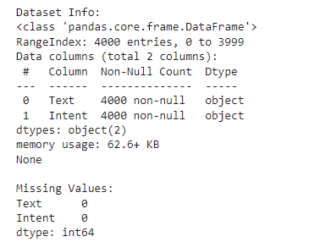
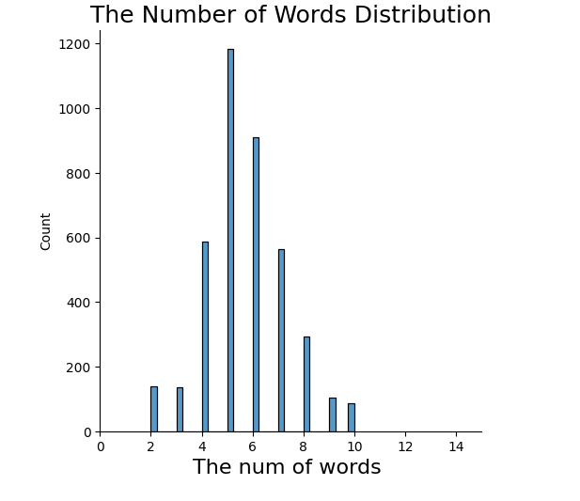
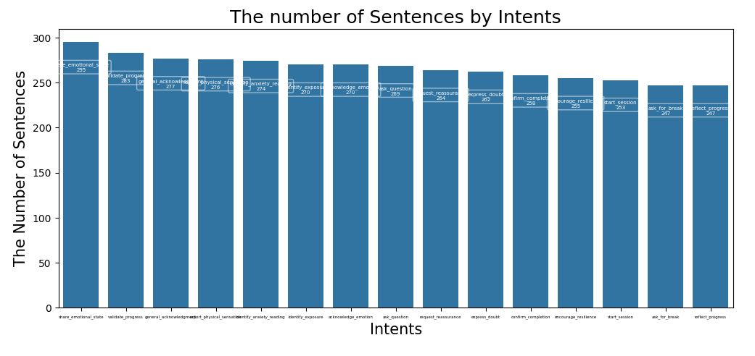
Data Visualization
IT21234484 | Jayasinghe P.T. | 24 – 25J – 046

Slide 48
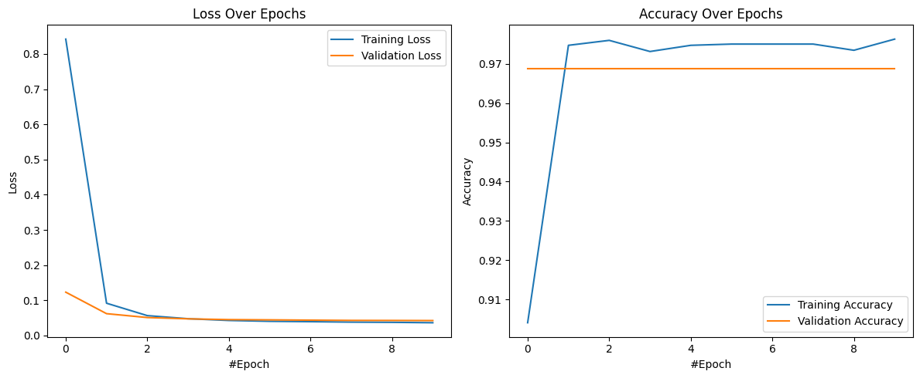
Intent Recognition DistilBERT Model
Loss – 0.0425
Accuracy – 0.9688
IT21234484 | Jayasinghe P.T. | 24 – 25J – 046

Slide 49
Functional, Non-Functional and Personnel Requirements
Functional Requirements
Train and fine-tune a DistilBERT-based model for identifying user intents from natural language input.
Implement keyword-matching algorithms to identify exposure types in real-time.
Design and implement a state-based logic flow for seamless and responsive conversational management.
Maintain a conversation state to track user progress and provide feedback dynamically.
Non-Functional Requirements
Ensure seamless processing of audio data and keyword identification with minimal latency.
Implement a robust and user-friendly interface that allows easy interaction between the IVA and patients.
Ensure scalability to support a growing number of users and expanding datasets
Provide strong data encryption and compliance with GDPR, HIPAA, and other regulations for handling sensitive patient information.
Personal requirements
Dr. Roshan Fernando: Psychiatrist guiding the overall research project, providing insights into OCD diagnosis and treatment methodologies.
Ms. Sandaru Fernando: Psychologist assisting in the development of the dataset and providing expertise in psychological assessment.
IT21234484 | Jayasinghe P.T. | 24 – 25J – 046

Slide 50
Completion and Future Works
65% Completion of the components
Fine-tuned a DistilBERT-based model for accurate intent classification.
Designed and implemented a keyword-based extraction system for identifying exposure types from user inputs.
Developed and tested a robust rule-based conversational flow tailored to OCD treatment.
35% Future Enhancements
Extend the IVA functionality into a React Native mobile application for better accessibility.
Implement the Speech-To-Text and Text-Speech functionality.
Optimize response generation.
IT21234484 | Jayasinghe P.T. | 24 – 25J – 046

Slide 51
References
[1] Woebot: A mental health chatbot that offers support for anxiety and depression but lacks specialized OCD treatment and ERP integration. [Online]. Available: https://woebothealth.com. [Accessed: Jan. 20, 2024].
[2] Wysa: An AI-powered mental health app with conversational capabilities, focusing on generalized anxiety and mood management but not tailored for OCD or ERP. [Online]. Available: https://wysa.io. [Accessed: Jan. 20, 2024].
[3] Replika: A chatbot designed for companionship and support, offering personalized conversations but not specialized for therapeutic interventions like ERP. [Online]. Available: https://replika.ai. [Accessed: Jan. 20, 2024].
[4] Youper: An AI-powered emotional health assistant that tracks mood and offers CBT-based exercises but does not specifically focus on ERP for OCD. [Online]. Available: https://www.youper.ai. [Accessed: Jan. 20, 2024].
IT21234484 | Jayasinghe P.T. | 24 – 25J – 046

Slide 52
AI-Enhanced Video Conferencing ERP Therapy
IT21209420 | Mallawaarachchi D.E.H.
Specialization: Software Engineering
IT21209420 Mallawaarachchi D.E.H | 24 – 25J – 046

Slide 53

Introduction
Background on OCD
Traditional ERP therapy for OCD needs a lot of time and specialized care, making it hard for many people to access.
Stigma around mental health makes people hesitant to seek help, which worsens their symptoms.
Importance of the Study
AI-enhanced video conferencing can make ERP therapy more accessible and offer personalized, real-time care.
Using biometric analysis, this method can better monitor anxiety and stress levels, improving treatment results.
IT21209420 Mallawaarachchi D.E.H | 24 – 25J – 046

Slide 54
Research Questions
Primary Questions
How does AI video therapy help OCD patients access treatment better than in-person therapy?
How effective is AI video therapy in reducing OCD symptoms?
How do patients feel about using AI video therapy? Is it easy and acceptable?
Secondary Questions
How does biometric analysis help track and improve outcomes in AI video therapy?
What are the cost differences between AI video therapy and traditional methods for patients and providers?
IT21209420 Mallawaarachchi D.E.H | 24 – 25J – 046

Slide 55

Objectives
Main Objective
Sub Objectives
Develop an AI-Enhanced Video Conferencing ERP Therapy tool to facilitate more accessible, personalized, and effective OCD treatment.
Real-time Biometric Detection: Implement AI models to capture and analyze facial features for anxiety and stress detection during therapy.
Seamless Video Conferencing: Develop a platform for uninterrupted audio-video communication between patients and therapists.
Session Analytics: Provide detailed session metrics and predictive analytics to monitor patient progress.
Enhanced Feedback: Display critical facial expressions alongside live video for accurate therapist assessment.
IT21209420 Mallawaarachchi D.E.H | 24 – 25J – 046

Slide 56
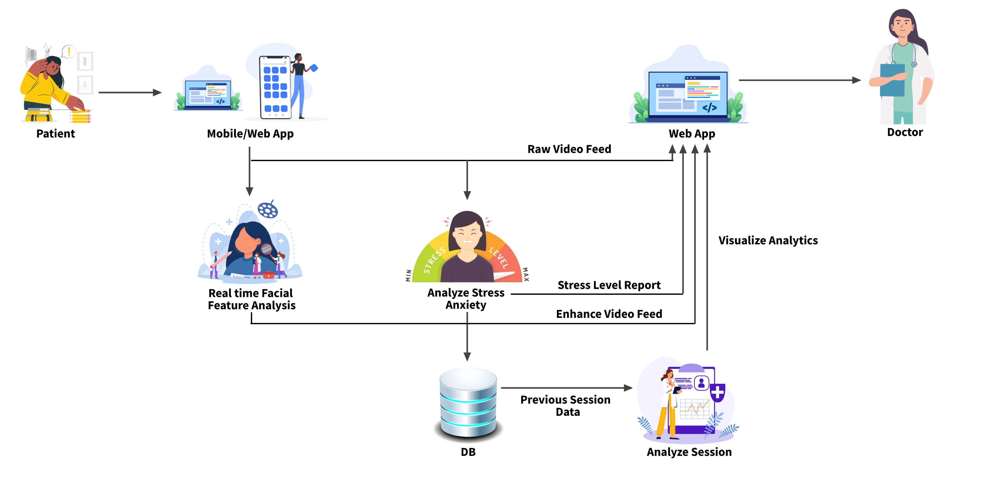
Methodology – System Diagram
IT21209420 Mallawaarachchi D.E.H | 24 – 25J – 046

Slide 57
Methodology – Technologies, Techniques, Algorithms
Techniques
Technologies
WebRTC
Node.js
socket.io
React
React Native
Python Flask
MongoDB
Google Colab
Algorithms
Facial Recognition
Emotion Detection
Real-time Facial Landmark Detection
Data Normalization
Feature Engineering
Data Validation
MediaPipe(CNN)
Gradient Boosting
Regression
IT21209420 Mallawaarachchi D.E.H | 24 – 25J – 046

Slide 58
Methodology – Evidence of Completion
Data Collection
Implemented video conferencing frontend using React
Data pre-processing
Developed a signaling server using Flask to manage WebRTC connections
Data Visualization
Trained a Gradient Boosting Regressor
Implemented facial feature analysis using MediaPipe
IT21209420 Mallawaarachchi D.E.H | 24 – 25J – 046

Slide 59
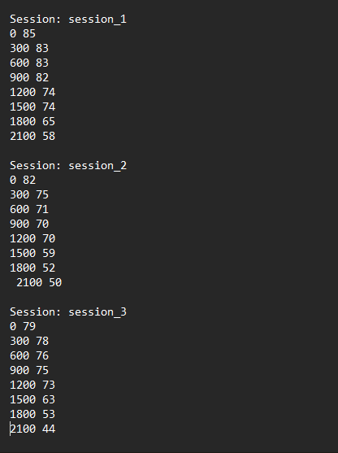
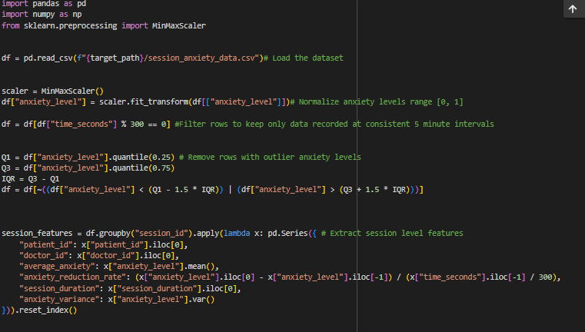
Data Collection and Pre-processing
Collected ERP session anxiety details
Data pre-processing implementation
IT21209420 Mallawaarachchi D.E.H | 24 – 25J – 046

Slide 60
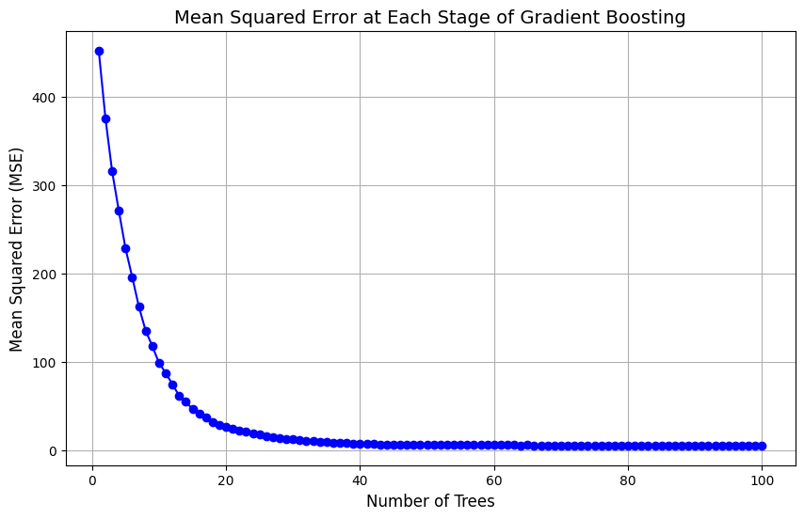
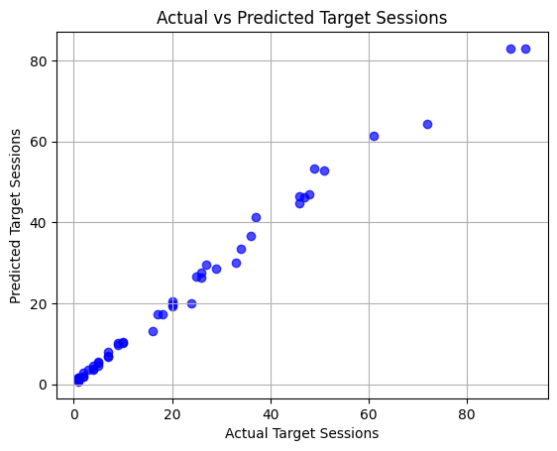
Data Visualization
IT21209420 Mallawaarachchi D.E.H | 24 – 25J – 046

Slide 61
Methodology – Software, Personal, and Software Specification Requirement
Functional Requirements
Real-time biometric analysis results should be displayed accurately to the therapist.
Seamless audio-video communication should be maintained throughout therapy sessions.
Session analytics should provide detailed and accurate metrics.
Critical facial expressions and emotional states should be highlighted accurately for therapist monitoring.
Non-Functional Requirements
Interfaces should be user-friendly and intuitive.
The platform should be compatible with different mobile devices.
The application should be reliable and maintain high availability.
Results should have high accuracy in biometric analysis and emotion detection.
The platform should be efficient in processing and displaying real-time data.
Personal requirements
Dr. Roshan Fernando: Psychiatrist guiding the overall research project, providing insights into OCD diagnosis and treatment methodologies.
Ms. Sandaru Fernando: Psychologist assisting in the development of the dataset and providing expertise in psychological assessment.
IT21209420 Mallawaarachchi D.E.H | 24 – 25J – 046

Slide 62
Completion and Future Works
65% Completion of the components
Developed the frontend for the video conferencing tool, leveraging WebRTC for seamless real-time communication.
Implemented a signaling server using Python Flask to facilitate video conferencing connections and signaling.
Trained and deployed a predictive algorithm to estimate the required number of therapy sessions.
35% Future Enhancements
Enhance the accuracy of the anxiety level detection model to ensure more precise predictions.
Implement a robust authentication mechanism and streamline the video conferencing experience for smoother interactions.
IT21209420 Mallawaarachchi D.E.H | 24 – 25J – 046

Slide 63
References
[1] S. Domb, E. Manly, and D. Elman, “Pandemic patch-up: Using ZoomTM videoconferencing software to create a virtual teaching clinic,” Canadian Family Physician, vol. 67, no. 1, pp. 65–68, Jan. 2021, doi: https://doi.org/10.46747/cfp.670165.
‌
[2] T. Newlin, T. McCall, P. Ottmar, B. Welch, and S. Khairat, “Assessing the Satisfaction of Citizens Using Teleconsent in Clinical Research,” Iospress.nl, pp. 685–689, 2018, doi: https://doi.org/10.3233/978-1-61499-852-5-685.
‌
[3] D. Darnell, M. D. Pullmann, T. D. Hull, S. Chen, and P. Areán, “Predictors of Disengagement and Symptom Improvement Among Adults With Depression Enrolled in Talkspace, a Technology-Mediated Psychotherapy Platform: Naturalistic Observational Study,” JMIR Formative Research, vol. 6, no. 6, p. e36521, Jun. 2022, doi: https://doi.org/10.2196/36521.
[4]K. G. Lockwood et al., “Evaluating a New Digital App–Based Program for Heart Health: Feasibility and Acceptability Pilot Study,” JMIR Formative Research, vol. 8, pp. e50446–e50446, May 2024, doi: https://doi.org/10.2196/50446.
‌
‌
‌
IT21209420 Mallawaarachchi D.E.H | 24 – 25J – 046

Slide 64
Thank You!

